Slide 1

Predictive Modeling and Machine Learning Insights from NYC Taxi Data
Prastut Dahal
Dipika Bogati
Ujjwal Kuikel

Slide 2

Introduction
Efficient transportation systems are the backbone of urban economies.
Understanding how transportation operates can improve the mobility and reduce inefficiencies
Predicting fares dynamics, transportation patterns and passenger’s behavior can help optimize resource allocation
Insights from this study can support sustainable urban planning and smart transit systems.

Slide 3
Questions we answered
Can we predict fair amount based on other features like trip distance, passenger count, etc?
Can we predict payment type based on other features?
Can we forecast future demand and revenue based on past data?

Slide 4
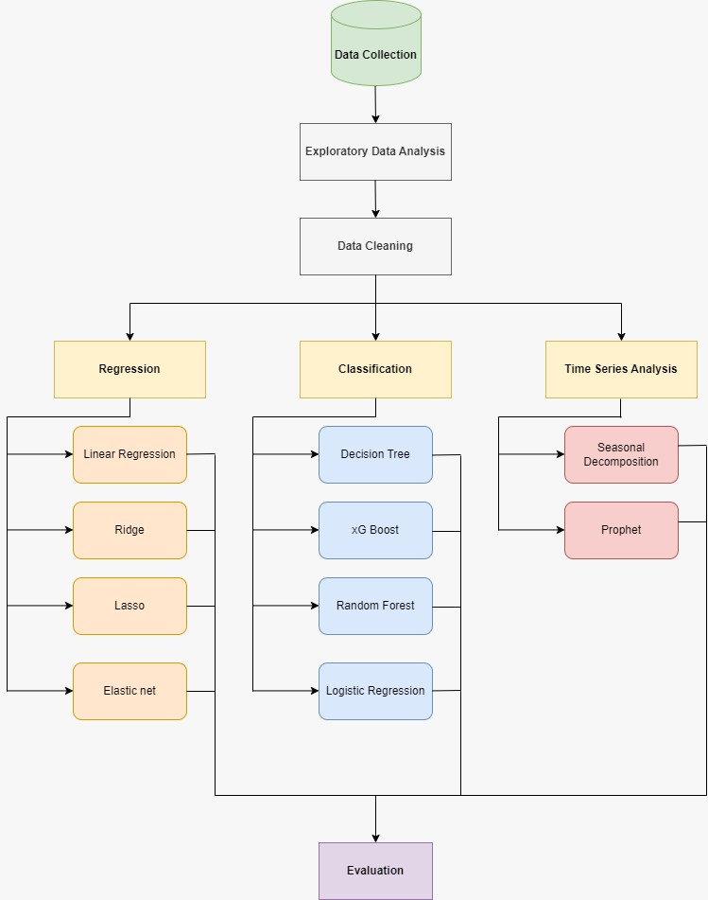
Methodology

Slide 5
Dataset
Source:
NYC Taxi & Limousine Commission (TLC) Yellow Taxi Trip Records
Open dataset with millions of trip records from NYC taxis
Key Features:
Trip Details: Pickup and drop-off locations, timestamps, trip distance
Fare Information: Total fare, tip amount, payment type
Passenger Data: Number of passengers per trip
Time-Related Attributes: Pickup time, dropoff time

Slide 6
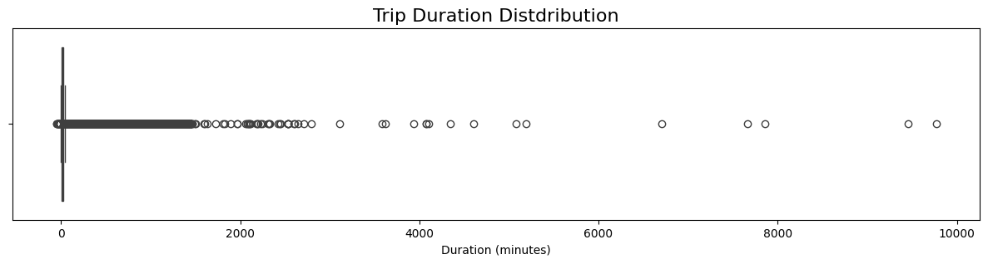
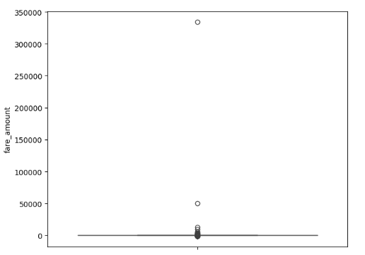
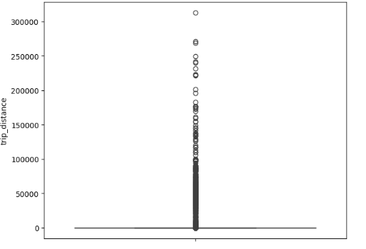
EDA

Slide 7
Data Cleaning
Handling Missing Data:
Checked for missing values and imputed or removed rows/columns as needed.
Feature Engineering:
Created new features (e.g., trip_duration, hour_of_day, day_of_week) based on raw data.
Encoded Categorical Variables:
Used one-hot encoding or label encoding for categorical data.
Handled Duplicates:
Checked for and removed duplicate rows to avoid skewing results.
Outlier Detection and Removal:
Identified and removed outliers in numerical features (e.g., extreme trip fares, durations).

Slide 8
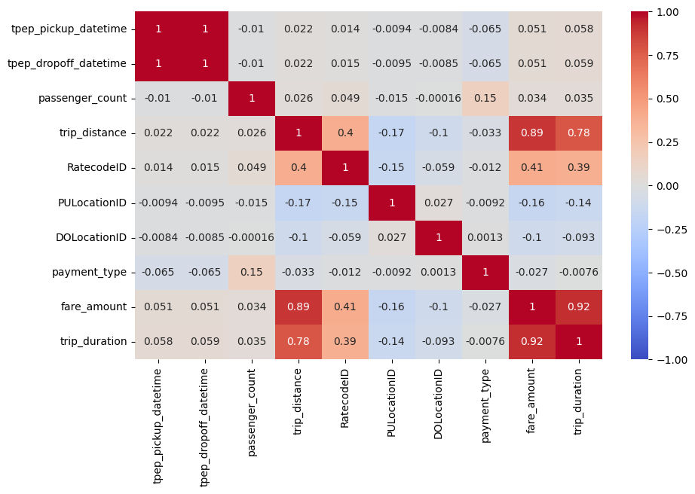
EDA

Slide 9
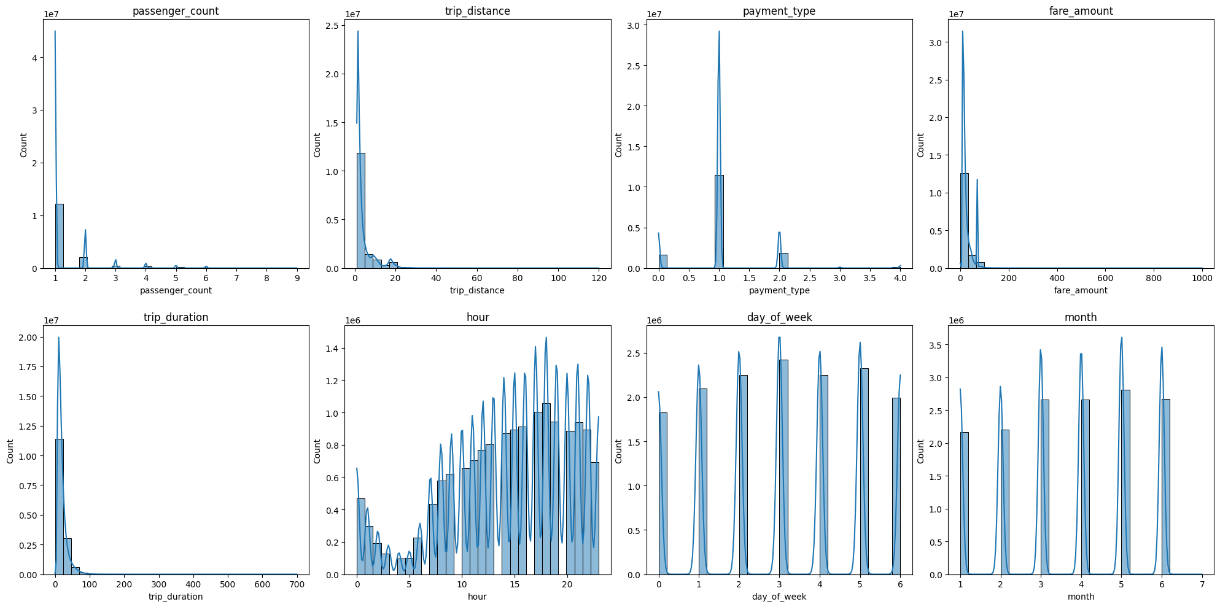
EDA

Slide 10
Regression
Linear Regression:
Fits a straight line that best represents the linear relationship between features and target.
Lasso Regression:
Uses L1 regularization to perform feature selection by driving some coefficients to zero.
Ridge Regression:
Applies L2 regularization to prevent overfitting by shrinking coefficients.
Elastic Net:
Combines L1 and L2 regularization for balanced feature selection and coefficient shrinkage.
Notes:
Linear Regression:
Assumes a linear relationship between independent and dependent variables, fitting a straight line that minimizes the sum of squared residuals.
Lasso Regression:
Applies L1 regularization by adding absolute value of coefficients to the loss function, effectively performing feature selection by driving some coefficients to zero.
Ridge Regression:
Uses L2 regularization by adding squared magnitude of coefficients to the loss function, which helps prevent overfitting by shrinking coefficients close to zero.
Elastic Net:
Combines both L1 and L2 regularization, providing a balanced approach that performs feature selection like Lasso while maintaining the coefficient shrinkage properties of Ridge regression.

Slide 11
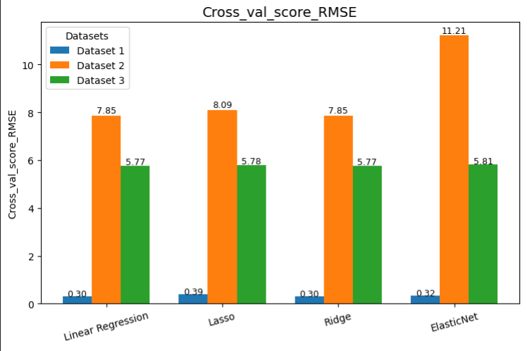
Regression

Slide 12
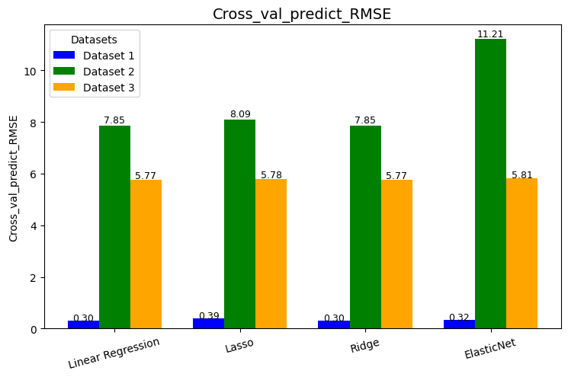
Regression

Slide 13
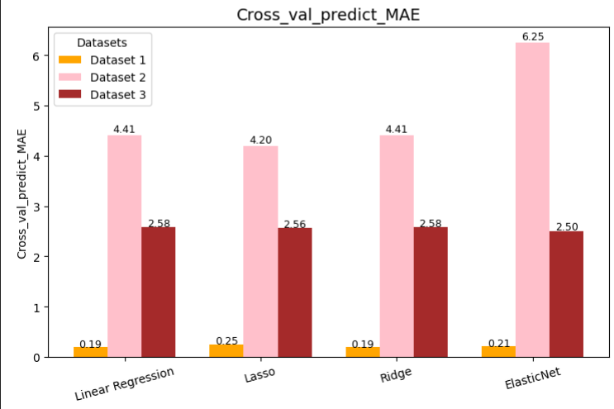
Regression

Slide 14

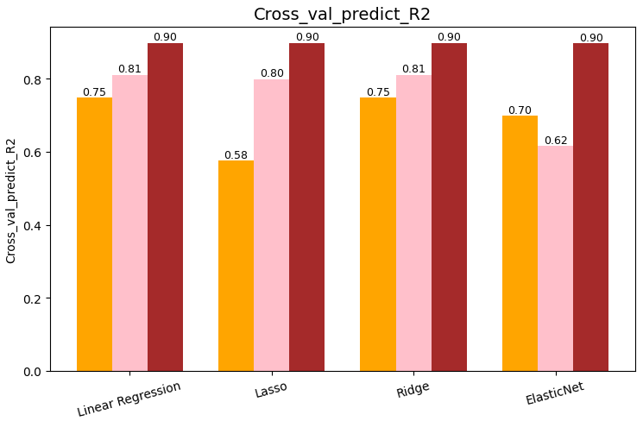
Regression

Slide 15
Classification
Logistic Regression: ​
Assumes there is linear relationship between features and target values, using a sigmoid function to transform linear combinations into probabilities.
Decision Tree:​
Captures both linear and non-linear relationships by hierarchically splitting data based on feature importance, creating a tree-like model of decisions.​
Random Forest:​
Combines multiple decision trees to make better predictions by using bootstrap aggregation and reducing overfitting through tree diversity.​
XGBoost:​
Unlike random forest, it creates one decision tree at a time, with each tree strategically designed to fix the mistakes from the previous tree using gradient descent.

Slide 16
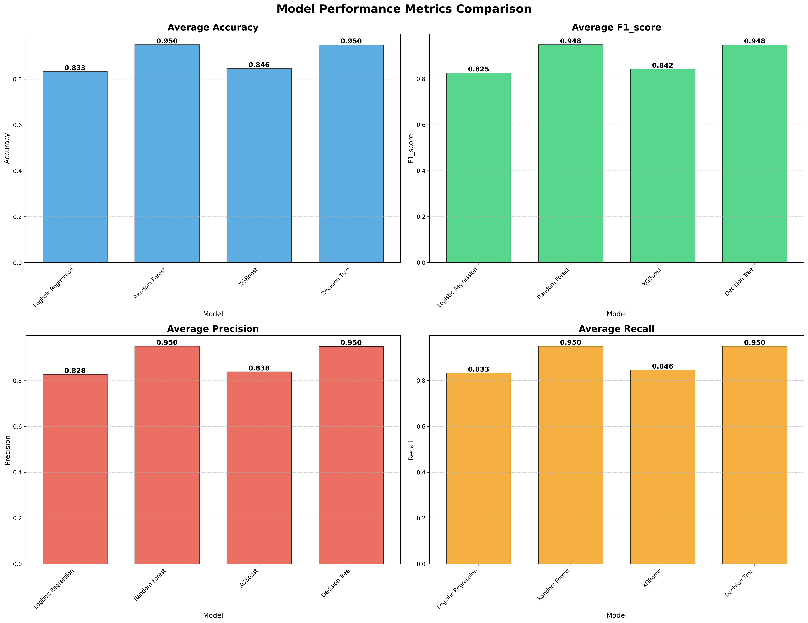
Average Accuracy

Slide 17
F1_Score

Slide 18
Precision

Slide 19
Recall

Slide 20
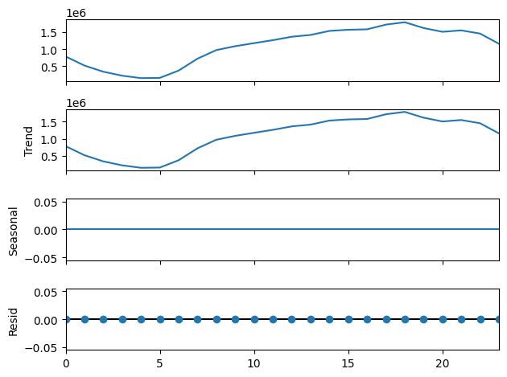
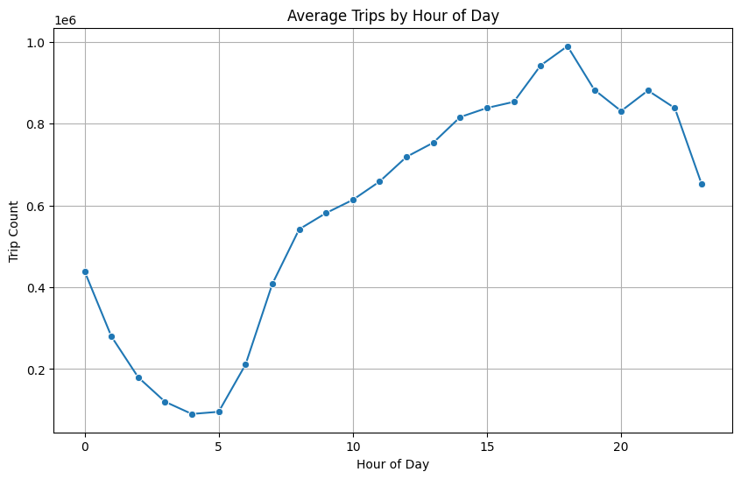
Hourly Demand

Slide 21
Weekly Demand

Slide 22
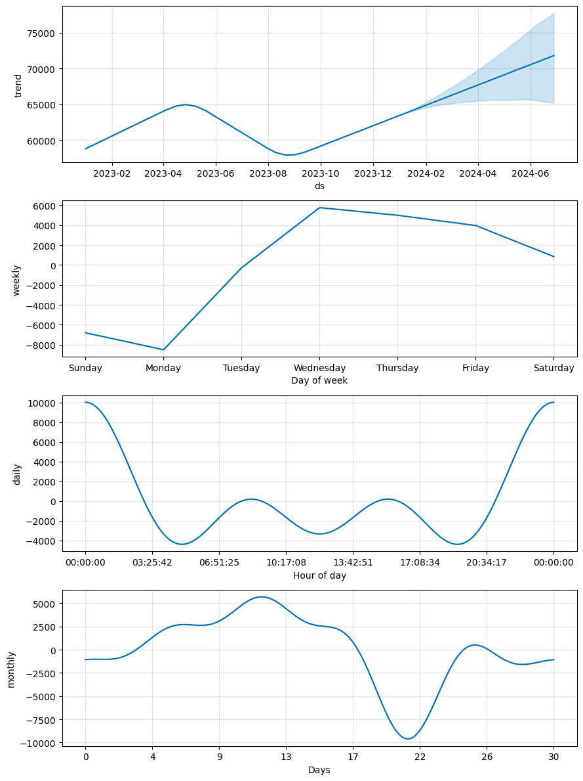
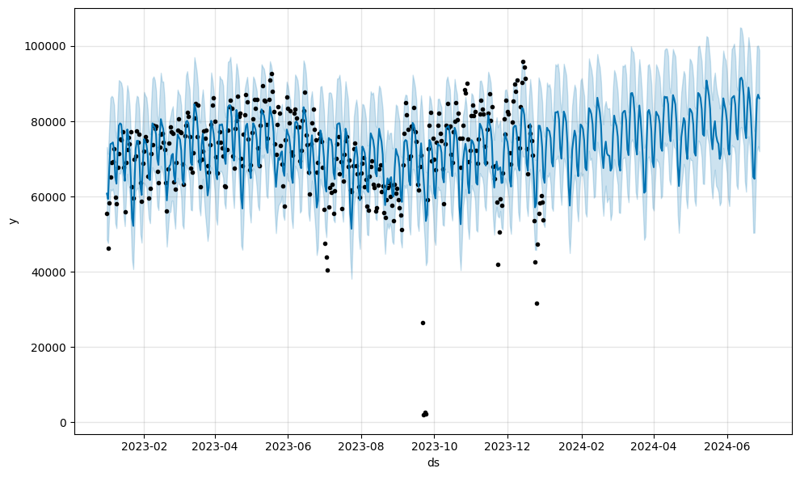
Forecasting

Slide 23
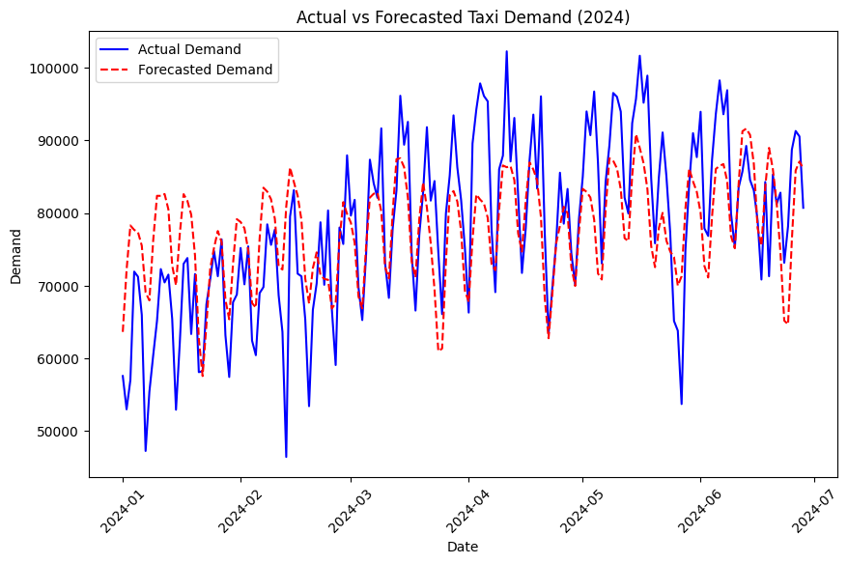
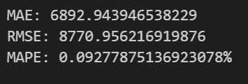
Regression

Slide 24
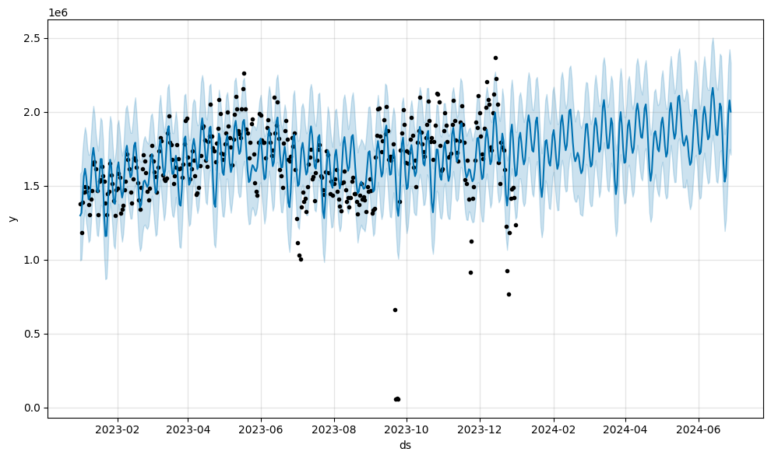
Regression

Slide 25
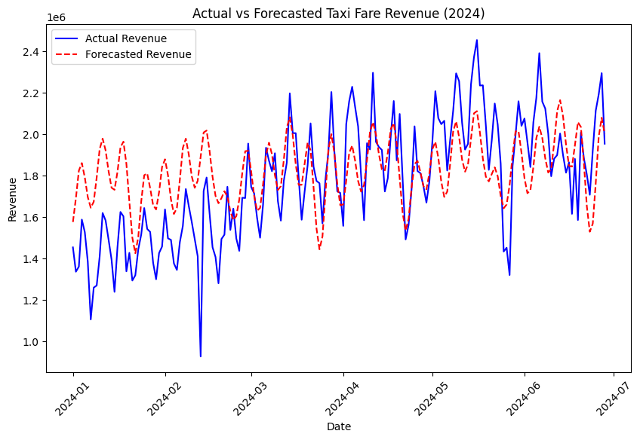
Regression

Slide 26
Conclusion

